Slide 1
Notification Bell
User Research Findings
Community Post, Walkthrough Interviews, Card Sort

Slide 2
Community Forum

Slide 3
Community Forum Freelancer Responses
Dislike redundancies and duplications of email messages
Prefer not to receive notifications for bad news like declines or rejections
Do not need notifications for self-initiated actions
Prefer messages from Upwork to show up under the bell, but only if it’s something new.
Messages from client don't need notification under the bell because already have message count
If do not need to reply immediately, good to know what I still have to catch up on within the site.
Fun if a bell actually rang every time awarded a job. Ding, ding!
https://community.upwork.com/t5/Freelancers/Notification-bell-feedback/m-p/214260#M127232

Slide 4
Community Forum Client Responses
Use after billing to quickly get to my transactions to download for personal reporting spreadsheet.
Volume is overwhelming when all applicants apply to a job posting
Maybe omitting the bell notifications for user-initiated actions would be more efficient
Nice to get notified while on the site without having to switch over to e-mail client
Nice if instead of the dot we see number of new/unchecked notifications/events.
https://community.upwork.com/t5/Clients/Notification-bell-feedback/m-p/214307#M11395

Slide 5
Wakthrough Interviews

Slide 6
Interview Guide

Slide 7
Interview Participants
Freelancers
Clients
Experienced, “Top Rated”
Based in US and overseas
5 freelancers and 2 agencies
Experienced
Based in US
5 clients
https://docs.google.com/a/odesk.com/document/d/1D24ochbYOZXgWDwSs2YV5xJzFUFJ8sDm-R2NGeh8alM/edit?usp=sharing

Slide 8

Good Feedback Matters

Slide 9
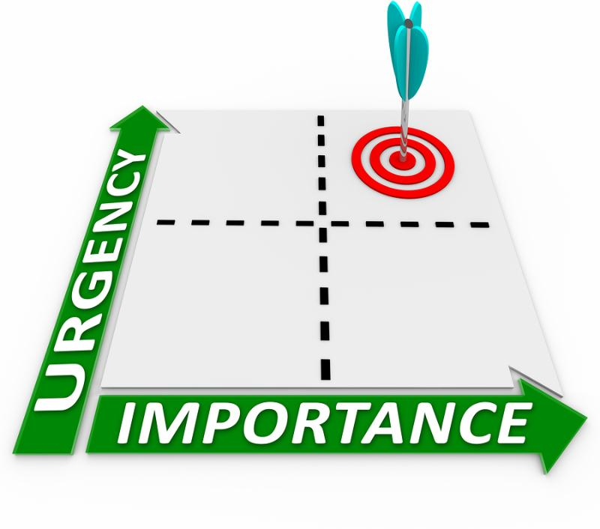

Prioritization

Slide 10

Distinguish action items
vs.
Not Addressed

Slide 11


Distinguish work mode
vs.

Slide 12

Timing of Notifications

Slide 13
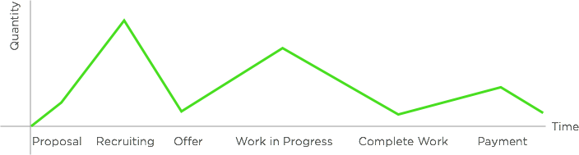
Notification/Email Volume

Slide 14
Common Needs
Explicit
Need sorting of notification by FYI vs. Action Item
Need to see whether notification is read or not
Need to archive or save notifications rather than delete
Latent
Ability to adjust volume of notifications, alerts, and workflow based on mode (hiring or contract mode)
Adjust timing of notifications and alerts based on work hours
Mute or silence certain notifications that are deemed irrelevant
Pause or cancel contract when either party is no longer responsive (no activity) without leaving feedback
Track deadlines outside of messages for hourly contracts

Slide 15
Freelancer Walkthroughs

Slide 16
FL User Workflows
Clients always come first
Typically stay notified and up to date through emails and navigate through the site through clicking on emails
Finding work and doing contract work are two separate workflows and require different mental states
Time and day of the week matters. Weekends are usually prompted by emails while weekdays are prompted by notifications in app or emails
https://docs.google.com/a/odesk.com/document/d/1D24ochbYOZXgWDwSs2YV5xJzFUFJ8sDm-R2NGeh8alM/edit?usp=sharing

Slide 17
Experienced FL Workflow Priorities
Job Search mode
Job invite response (when looking for work) / hiring dance
Job search and reviewing recommended jobs
In Contract mode
Client messaging
Time logging (hourly) / checking milestones (fixed)
Get paid and give feedback at end of contract

Slide 18
Freelancer Needs
Explicit
More differentiated notifications of non-standard / strange events as compared to email
Reminders of certain periodic actions like withdraw money or time logging
Prioritizing messaging response (who to respond to first) such as preview of messages
Latent
Personalized/customizable job search
Encourage applying to more jobs (i.e. through connects)
More efficiently log manual time (frequent activity)

Slide 19
Client Walkthroughs

Slide 20
CL User Workflows
Macromanagers who rely on email as trigger for updates as to what is happening on their account and what action items to take (messages, etc); check in weekly or bi-weekly on contracts to review timelog
High-Volume Micromanagers check in frequently (every morning or throughout the day) to check status / activity
If hiring, they check much more often (sometimes without prompting) to respond to messages
If in contract, only check in to respond to messages and periodically check timelong/payment summary
Time and day of the week matters for when to check in
https://docs.google.com/a/odesk.com/document/d/1nWFVYJ6eI2_HriNLi-xQ7EQHq7_CmJuehydn91gROwc/edit?usp=sharing

Slide 21
Experienced CL Workflow Priorities
Job hiring mode (new bids or proposals to open contracts)
Respond to active bid proposals
Search for freelancers to invite (sometimes)
In contract mode
Respond to messages from hired freelancer
Check time logged in active contracts
Pay freelancer and give feedback
(Periodically) Payment report check

Slide 22
Client Needs
Explicit
Varied monitoring of freelancers (more for newly hired freelancers and less of freelancers with prior work history)
Know when freelancer is online or starting to work to initiate communications
Better messaging management (grouping of like items and differentiation between disparate chats)
Latent
Sort through and reply to high volumes of job applicants (20+)
Personalized/customizable freelancer search
High-level overview of payments and tracking of individual transactions

Slide 23
Card Sort Survey

Slide 24
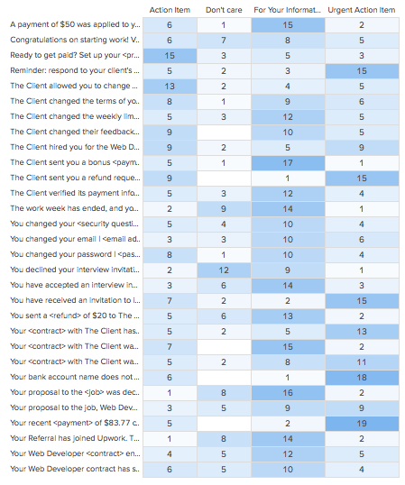
Hybrid Card Sort
Urgent = something that affects reputation (response required)
Action item = payment, refund, review work
FYI = user-initiated actions
Don’t care = declined

Slide 25
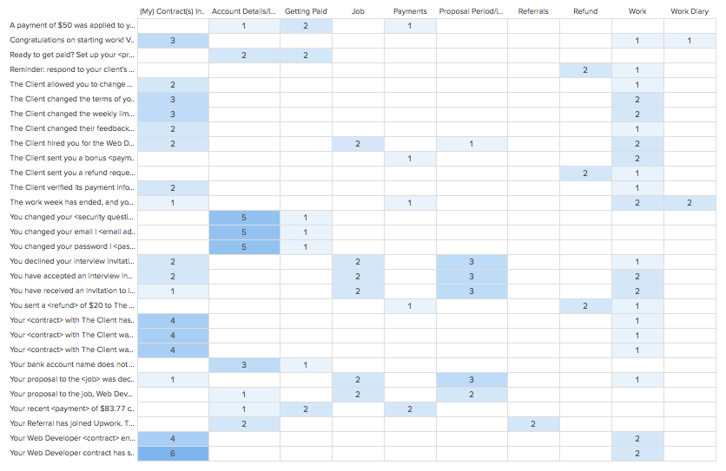
Open Card Sort
Common Categories:
Account Details
Proposal Period
My Contracts
Work
Payments

Slide 26
Affinity Diagramming

Slide 27
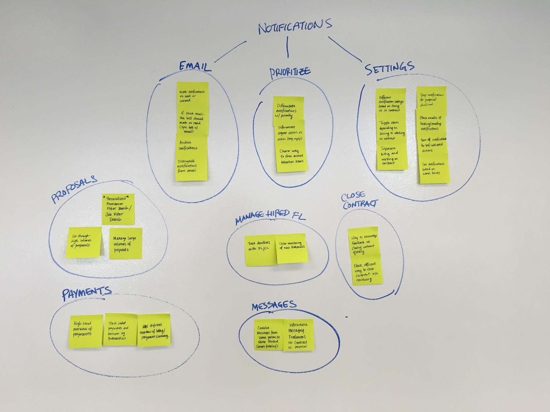
Client Affinity Diagram

Slide 28
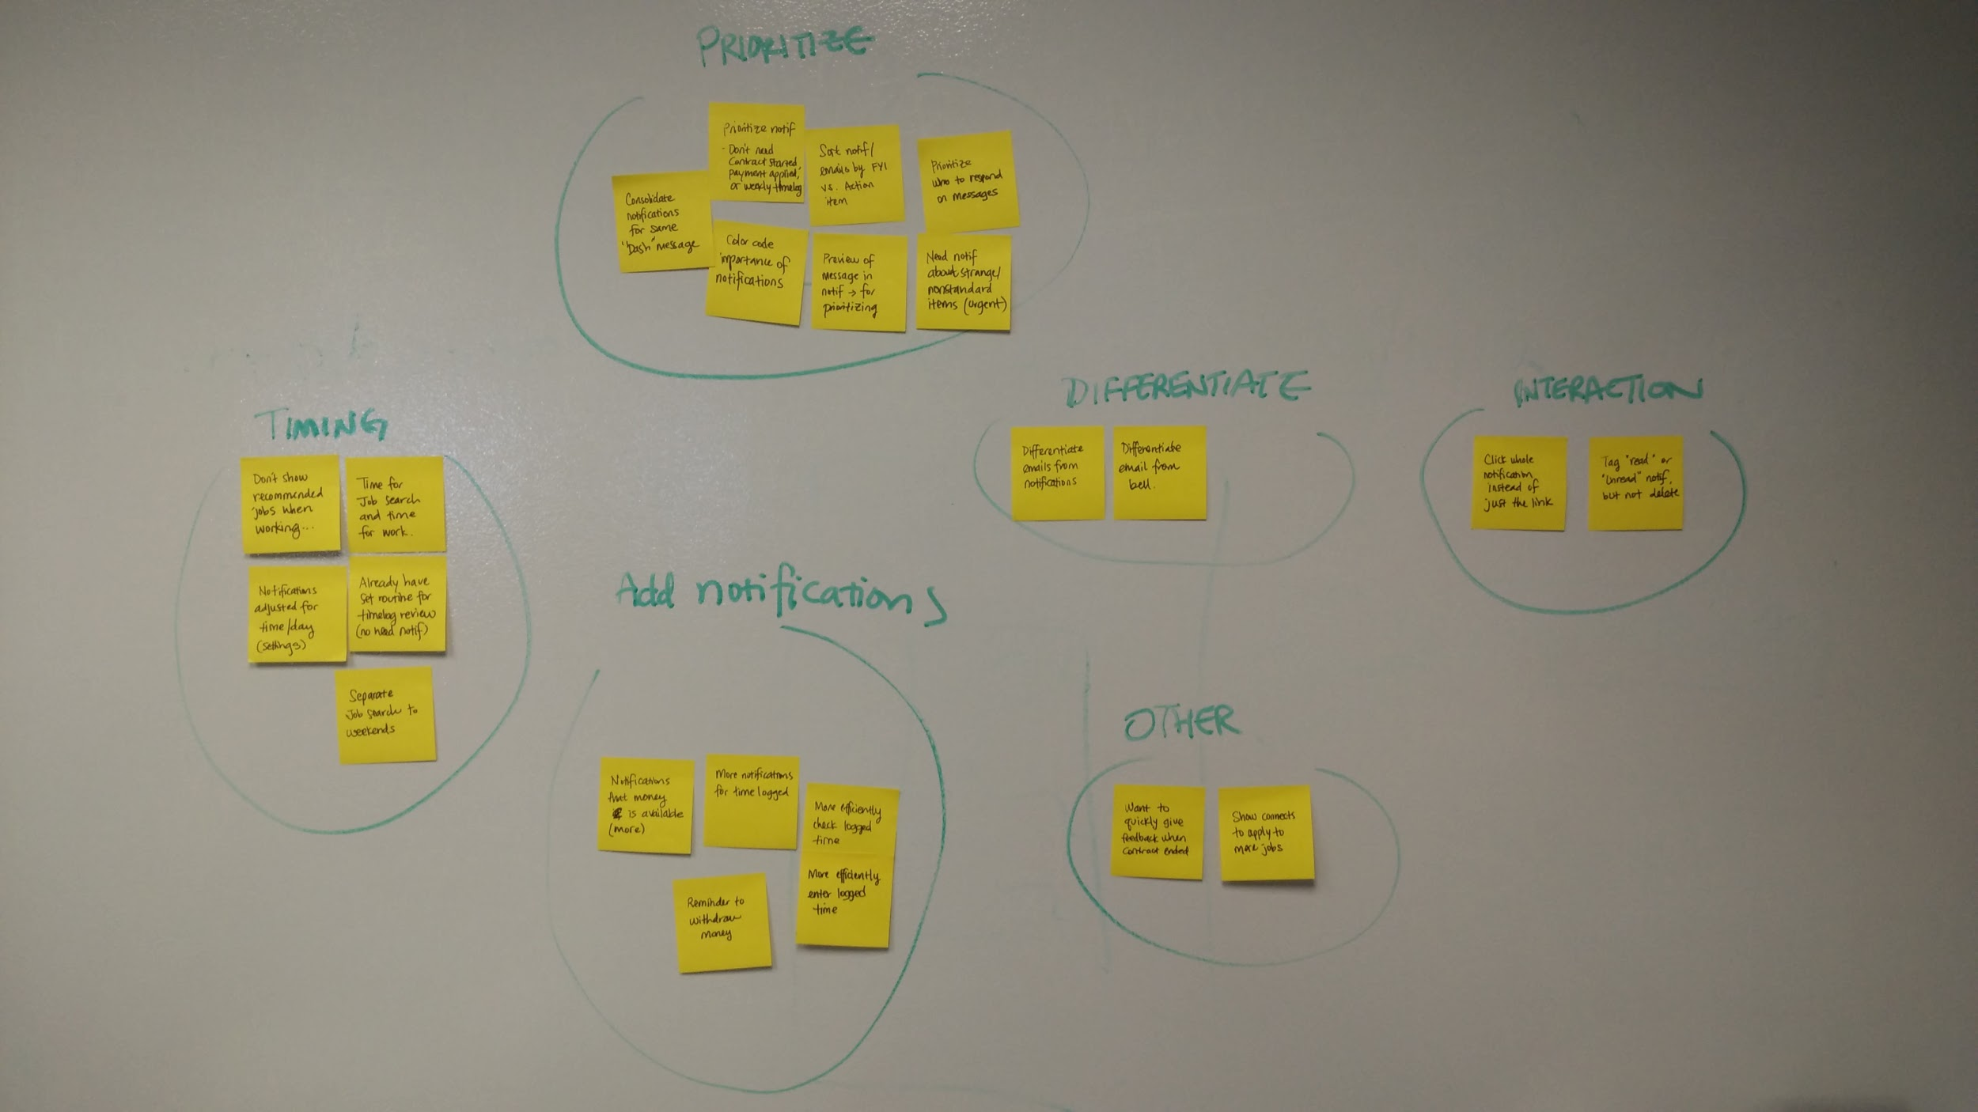
Freelancer Affinity Diagram

